Slide 1
Software SASD
Public Transportation
System
T e a m NO.3
201311269 김제헌
201311275 박상희
201311276 박형민
201311287 엄현식

Slide 2
I N D E X
01 Former SA
02 Changed SA
03 SD

Slide 3
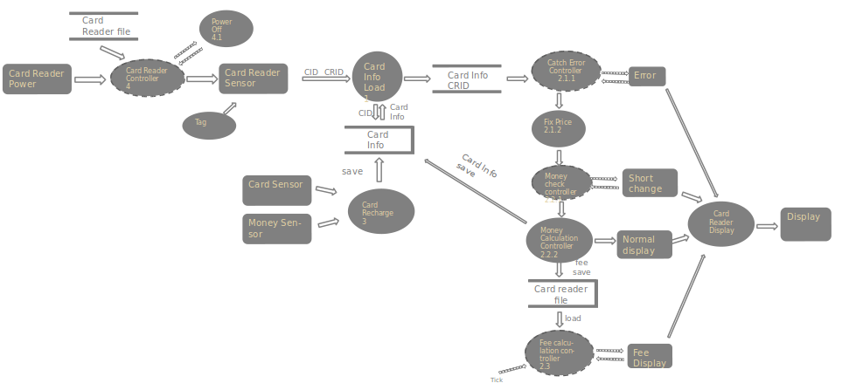
0 1 Former

Slide 4
0 2 S A
Public Transportation System

Slide 5
0 2 S A
The Context Diagram
Card
update
PTS
Control
Sensor
Card info input
display
Monitor
Adjust stat
recording
Company
Card Reader
Digital Clock

Slide 6
0 2 S A
DFD Level 0
Card
update
Card info input
PTS
Control
0
Sensor
display
Monitor
Adjust stat
recording
Company
Card Reader
Digital Clock

Slide 7
0 2 S A
DFD Level 1
Card
update
Card Info load
1
PTS
Control
2
Sensor
CID, CRID
Card Info
display
Monitor
Company
recording
Card Reader
Adjust stat
Digital Clock

Slide 8
0 2 S A
DFD Level 2
Card Info load
1.1
Card Info load
1.2
Sensor
Signal
CID, CRID
Card Info
Display interface
2.2
display
Monitor
Display data
Payment
Control
2.1
Card
Interface
2.3
Card Info
Card data
update
Card
Card Reader
data
Adjust stat
Card Reader recording
Interface
2.4
record
Company
Card Reader
Digital Clock

Slide 9
0 2 S A
DFD Level 3
Result
2.1.4
Display data
Display data
Display data
Enable
Updated Card Info
CRID
Disable
Catch error control 2.1.1
Card Info
CRID
Money check
Control
2.1.2
Payment
Controller
2.1.3
Card update
2.1.5
Card Info
trigger
Card data
Company
trigger
Card Reader Record
2.1.6
Card Reader
data
Adjust stat
Digital Clock

Slide 10
0 2 S A
/enable “Result”
Result
Tick[record== true]
/disable “Card Reader Record”
Enable “Result”
Tick[update == true]
/disable “Card Update”
Enable “Result”
/disable “Result”
Trigger “Card Update”
/disable “Result”
Trigger “Card Reader Record”
Card Update
Card Reader Record

Slide 11
0 2 S A
DFD Level 4
Error
2.1.1.2
Display data
Trigger
Catch error controller 2.1.1.1
Card Info
Display data
Enable
Company
Adjust stat
Disable
Fix price
2.1.1.3
Short
2.1.2.2
Trigger
price
Calculation
2.1.2.3
Payment controller 2.1.3
Updated data
Money check controller 2.1.2.1
Enable
Disable

Slide 12
0 2 S A
Fix price
/enable “Fix price”
Tick[Error == 1]
/disable “Fix price”
trigger “Error”
Tick
/disable “Error”
enable “Fix price”
Error

Slide 13
0 2 S A
Calculation
/enable “Calculation”
Tick[noMoney == 1]
/disable “Calculation”
trigger “Short”
Tick
/disable “Short”
enable “Calculation”
Short

Slide 14
Sensor
Error
2.1.1.2
Card Info
Trigger
Display data
Signal
Catch error controller 2.1.1.1
Display interface
2.2
display
Monitor
Card Info load
1.1
Adjust stat
Disable
Display data
Enable
CID, CRID
Company
Fix price
2.1.1.3
Display data
Result
2.1.4
Card
Card Info load
1.2
price
update
Short
2.1.2.2
Card
Interface
2.3
Money check controller 2.1.2.1
Trigger
Enable
Disable
Enable
Card Reader
Payment controller 2.1.3
Card data
Disable
Calculation
2.1.2.3
Updated data
Card update
2.1.5
record
trigger
trigger
Card Reader Record
2.1.6
Card Reader
data
Card Reader recording
Interface
2.4
Digital Clock

Slide 15
0 2 S A
Recharger System

Slide 16
0 2 S A
The Context Diagram
Card
update
recharge
Recharger
System
Sensor
display
Monitor

Slide 17
0 2 S A
DFD Level 0
Money Sensor
money
Recharger
Control
0
update
Card
Recharger Sensor
CID
display
Monitor

Slide 18
0 2 S A
DFD Level 1
Card
Info
Loader
1
Recharger
Control
2
Recharger
Sensor
update
Card
CID
Card Info
display
money
Money Sensor
Monitor

Slide 19
0 2 S A
DFD Level 2
Update
Interface
2.2
update
card data
update
Recharger
Sensor
Input
Card ID
Receive
Interface
1.1
Card
Info
Loader
1.2
Recharger
Control
2.1
CID
Card Info
display
data
money
Display
Interface
2.3
Money
Sensor
Interface
2.4
Money
Sensor
Input
display

Slide 20
0 2 S A
DFD Level 3
Update
2.1.2
update
card data
enable
Recharger
Control
2.1.1
Card Info
disable
money
trigger
Display
2.1.3
display data

Slide 21
0 2 S A
/ enable
“update”
update
Tick [update == true]
/ disable “update”
Trigger “display”
/disable “display”
enable “update”
display

Slide 22
Recharger
Sensor
Input
Card ID
Receive
Interface
1.1
Card
Info
Loader
1.2
Recharger
Controller
2.1.1
Recharger
Sensor
CID
Card Info
Money
Sensor
Input
Money
Sensor
Interface
2.4
money
Money Sensor
Update
2.1.2
Update
Interface
2.2
update
card data
update
Card
enable
Recharger
Controller
2.1.1
Card Info
disable
money
trigger
Display
2.1.3
Display
Interface
2.3
display data
display
Monitor

Slide 23
0 2 S A
Fee Calculation System

Slide 24
0 2 S A
The Context Diagram
Monitor
display
fee data, CRID input
Fee
Calculation
System
Card Reader
Company
send
reset
Tick
Card Reader

Slide 25
0 2 S A
DFD Level 0
Monitor
display data
fee data
CRID
Fee
Calculation
Control
0
Card Reader
Company
send data
reset
command
Tick
Card Reader

Slide 26
0 2 S A
DFD Level 1
Display
Interface
3
display data
Monitor
adjusted data
Card Reader Info
Loader
1
fee data,
CRID
Fee
Calculation
Control
2
adjusted
data
Send
Interface
4
send data
Company
reset command
Tick
Card Reader

Slide 27
0 2 S A
DFD Level 2
Display
2.2
adjusted data
Display
Interface
3
display data
Monitor
enable
fee data,
CRID
Fee
Calculation
Controller
2.1
disable
Send
2.3
adjusted data
Send
Interface
4
trigger
send data
Company
Tick
trigger
Reset
2.4
reset data
Card Reader

Slide 28
0 2 S A
Adjust
trigger “Send”
[adjust_well==1] trigger “Display”
trigger “Reset”
Send
Display
Reset

Slide 29
Display
2.2
adjusted data
Display
Interface
3
display
Monitor
enable
CRID
fee data,
CRID
Fee
Calculation
Controller
2.1
disable
Card Reader
Card Reader Info
Loader
1
Send
2.3
Send
Interface
4
trigger
adjusted data
send
Company
Tick
trigger
Reset
2.4
reset data
Card Reader

Slide 30
0 3 S D
Public Transportation System

Slide 31
main
0 3 S D
Basic
Price, error, CRID, Card Info
Price, Card Info
Short
Price, Card Info, Short, error, CRID
Catch Error Controller
Money check Controller
Payment Controller
Adjust
stat
enable
disable
trigger
enable
disable
trigger
enable
disable
trigger
trigger
Card Info
Short
Card Info Loader
Company
Fix Price
Error
Calculation
Short
Result
Card update
Card Reader Record
CID
CRID
Display data
Card data
Card Reader data
Card ID Receive Interface
Result
Interface
Card update
Interface
Card Reader Record
Interface
signal
Sensor

Slide 32
0 3 S D
Advanced
main
Price, Card Info, Short, error, CRID
Price, error, CRID, Card Info
Price, Card Info
Short
Catch Error Controller
Money check Controller
Payment Controller
Card Info
Adjust
stat
enable
disable
trigger
enable
disable
Short
trigger
enable
disable
trigger
trigger
Card Info Loader
Company
Fix Price
Error
Calculation
Short
Result
Card update
Card Reader Record
CID
CRID
Display data
Card data
Card Reader data
Card ID Receive Interface
Result
Interface
Card update
Interface
Card Reader Record
Interface
signal
Sensor

Slide 33
0 3 S D
Recharger System

Slide 34
Basic
0 3 S D
main
Controller
card info
money
recharged
card data
recharged
card data
Enable
Disable
trigger
Card Info
Loader
Money sensor
Interface
Update
Display
CID
updated card data
display
card data
Card ID Reader
Interface
Update Interface
Display
Interface

Slide 35
0 3 S D
Advanced
main
Recharger
Controller
recharged
card data
card info
trigger
money
recharged
card data
Enable
Disable
Card Info
Loader
Money Sensor Interface
Update
Display
CID
updated card data
display
card data
Card ID Reader Interface
Update Interface
Display
Interface

Slide 36
0 3 S D
Fee Calculation System

Slide 37
main
0 3 S D
Basic
Controller
fee data,
CRID
adjusted data
Enable
Disable
adjusted data
trigger
reset
data
trigger
Card Reader Info
Loader
Display
Send
Reset
display data
send data
Display Interface
Send Interface

Slide 38
main
0 3 S D
Advanced
Controller
reset data
fee data,
CRID
adjusted data
trigger
trigger
Enable
Disable
adjusted data
Card Reader Info
Loader
Display
Send
Reset
display data
send data
Display Interface
Send Interface

Slide 39
T-Money System
T H E E N D
T e a m NO.3

